Slide 1
NEIL GOGTE INSTITUTE OF TECHNOLOGY & KESHAV MEMORIAL ENGINEERING COLLEGE
DATA MINING
(PE625CS)
&
(PE622CSM)
By: Dr. P.MANASA
Assistant Professor, CSE.
NGIT

Slide 2
UNIT-1
INTRODUCTION TO DATA MINING

Slide 3
What is data mining?
The process of extracting information to identify patterns, trends, and useful data that would allow the business to take the data-driven decision from huge sets of data is called Data Mining.

Slide 4



Why do we need data mining?
Lots of data is being collected and warehoused
Web data
Google has Peta Bytes of web data
Facebook has billions of active users
purchases at department/ grocery stores, e-commerce
Amazon handles millions of visits/day
Bank/Credit Card transactions
Computers have become cheaper and more powerful
Competitive Pressure is Strong
Provide better, customized services for an edge (e.g. in Customer Relationship Management)

Slide 5


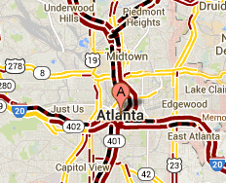
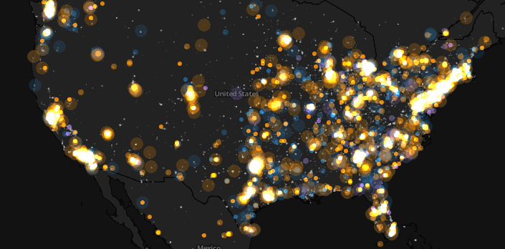
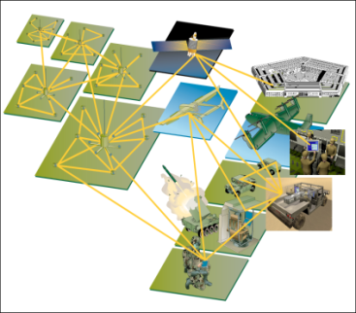
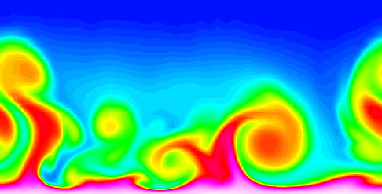
Why do we need data mining?
There has been enormous data growth in both commercial and scientific databases due to advances in data generation and collection technologies.
Cyber Security
E-Commerce
Traffic Patterns
Sensor Networks
Computational Simulations
Social Networking: Twitter

Slide 6

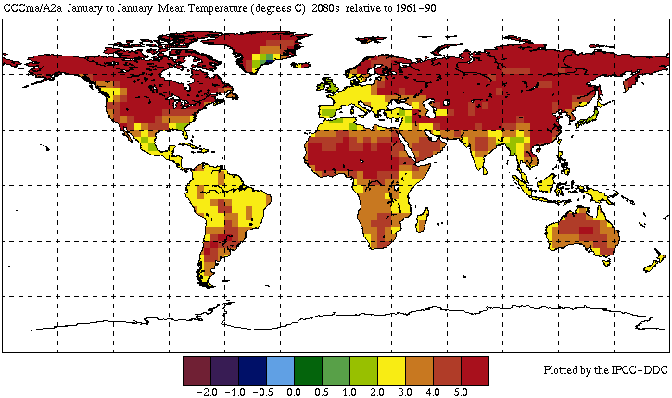


Great Opportunities to Solve Society’s Major Problems
Improving health care and reducing costs
Predicting the impact of climate change
Reducing hunger and poverty by
increasing agriculture production
Finding alternative/ green energy sources

Slide 7
Getting to Know Your Data Data Objects and Attribute Types

Slide 8
Type of Data:
Data sets differ in a number of ways.
Type of data determines which techniques can be used to analyze the data.
Quality of Data:
Data is often far from perfect.
Improving data quality improves the quality of the resulting analysis.
Preprocessing Steps to Make Data More Suitable for Data Mining:
Raw data must be processed in order to make it suitable for analysis.
Improve data quality,
Modify data so that it better fits a specified data mining technique.
Analyzing Data in Terms of its Relationships:
find relationships among data objects and then perform remaining analysis using these relationships rather than data objects themselves.
There are many similarity or distance measures, and the proper choice depends on the type of data and application.

Slide 9
What is Data Object?
Data sets are made up of data objects.
A data object represents an entity.
Also called sample, example, instance, data point, object, tuple.
Data objects are described by attributes.
An attribute is a property or characteristic of a data object.
Examples: eye color of a person, temperature, etc.
Attribute is also known as variable, field, characteristic, or feature
A collection of attributes describe an object.
Attribute values are numbers or symbols assigned to an attribute.
9

Slide 10
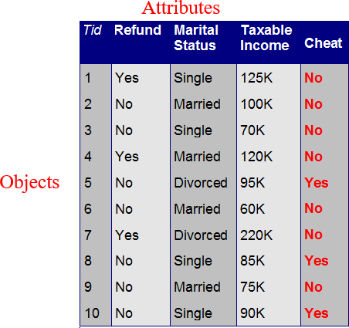
A Data Object
database rows ➔ data objects
database columns ➔ attributes

Slide 11
Attribute Types
Four main types of attributes
Nominal: Categorical (Qualitative)
categories, states, or “names of things”
Hair color, marital status, occupation, ID numbers, zip codes
An important nominal attribute: Binary
Nominal attribute with only 2 states (0 and 1)
Ordinal: Categorical (Qualitative)
Values have a meaningful order (ranking) but magnitude between successive values is not known.
Size = {small, medium, large}, grades, army rankings
Interval: Numeric (Quantitative)
Measured on a scale of equal-sized units
Values have order:
temperature in C˚ or F˚, calendar dates
Ratio: Numeric (Quantitative)
Inherent zero-point: ratios are meaningful
temperature in Kelvin, length, counts, monetary quantities

Slide 12
Discrete vs. Continuous Attributes
Discrete Attribute
Has only a finite or countably infinite set of values
zip codes, profession, or the set of words in a collection of documents
Sometimes, represented as integer variables
Continuous Attribute
Has real numbers as attribute values
temperature, height, or weight
Practically, real values can only be measured and represented using a finite number of digits
Continuous attributes are typically represented as floating-point variables

Slide 13
Types of data sets
Record
Relational records
Data matrix, e.g., numerical matrix, crosstabs
Document data: text documents:
term-frequency vector
Transaction data
Graph and network
World Wide Web
Social or information networks
Molecular Structures
Ordered
Video data: sequence of images
Temporal data: time-series
Sequential Data: transaction
sequences
Genetic sequence data
Spatial, image and multimedia:
Spatial data: maps
Image data:
Video data:

Slide 14
KDD- Knowledge Discovery from Databases
The main objective of the KDD process is to extract information from data in the context of large databases. It does this by using Data Mining algorithms to identify required knowledge.

Slide 15
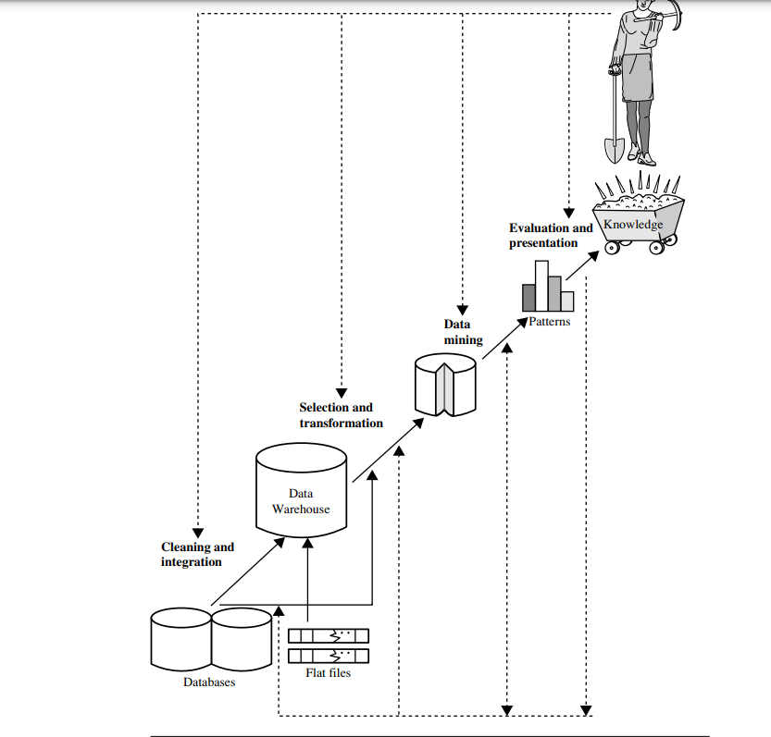

Slide 16
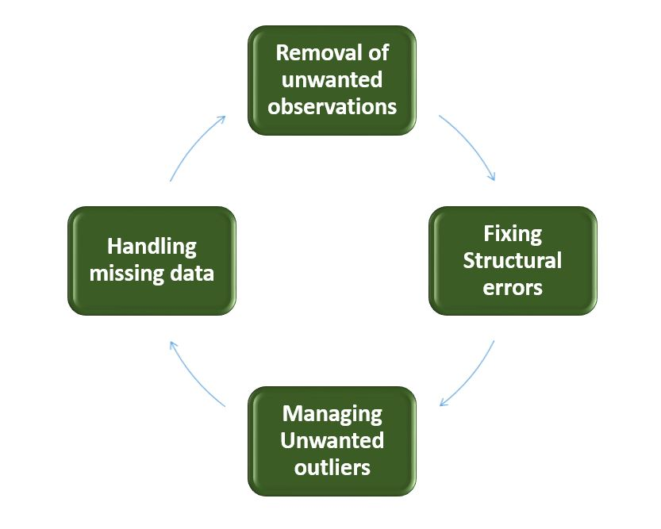
Data Cleaning
Data cleaning ensures the data is high quality and appropriate for analysis. it is the process of locating and fixing errors in a dataset. Data cleaning is crucial to fix missing and noisy values of real-world data that can negatively affect the system’s accuracy. It helps in improving overall data quality.

Slide 17
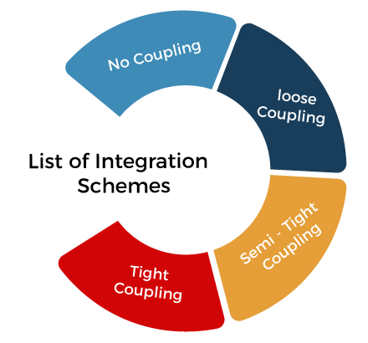
Data Integration
The process of merging data from various sources into a single, complete view is known as data integration. It is a complicated and repetitive process. Integration involves steps like ETL mapping, and conversion and begins after cleaning.

Slide 18
Data Selection
One of the primary steps in the KDD process is data selection. It is described as selecting the proper data source, kind, and instruments to gather the data. It prepares the foundation for the KDD process's further data transformation, mining, and knowledge presentation processes.

Slide 19
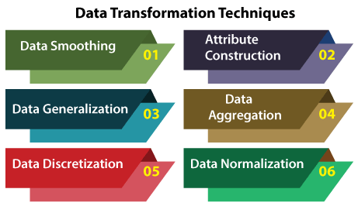
Data Transformation
Data transformation entails converting and altering the data to make the original data acceptable for analysis and knowledge discovery. It transforms raw data into a form that may be used for modelling and analysis.

Slide 20
Data Smoothing
Data smoothing is a process that is used to remove noise from the dataset using some algorithms.
Binning: This method splits the sorted data into the number of bins and smoothens the data values in each bin considering the neighborhood values around it.
Regression: This method identifies the relation among two dependent attributes so that if we have one attribute, it can be used to predict the other attribute.
Clustering: This method groups similar data values and form a cluster. The values that lie outside a cluster are known as outliers

Slide 21
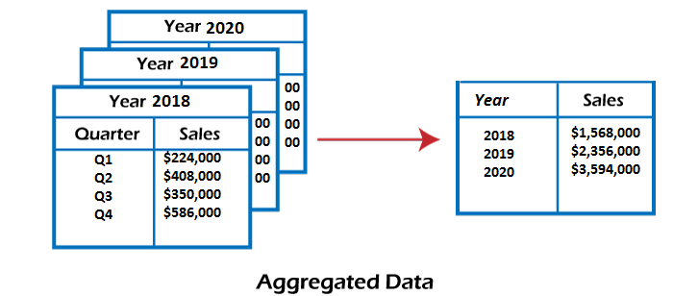
Attribute Construction
In the attribute construction method, the new attributes consult the existing attributes to construct a new data set that eases data mining.
Data Aggregation
Data collection or aggregation is the method of storing and presenting data in a summary format.

Slide 22
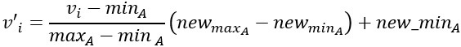
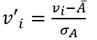
Normalization: Normalizing the data refers to scaling the data values to a much smaller range such as [-1, 1] or [0.0, 1.0].
Min-max normalization:
The formula for min-max normalization is given below:
Z-score normalization:
This method normalizes the value for attribute A using the meanand standard deviation. The following formula is used for Z-score normalization:

Slide 23
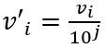
Decimal Scaling: This method normalizes the value of attribute A by moving the decimal point in the value.
The formula for the decimal scaling is given below: Here j is the smallest integer such that max(|v'_{i}|)<1
Data Generalization
It converts low-level data attributes to high-level data attributes using concept hierarchy.
Data Discretization
This is a process of converting continuous data into a set of data intervals.

Slide 24
Data Mining
To find patterns and associations that can be used to solve problems through data analysis, vast data sets are sorted using a process called data mining. Gaining insightful knowledge and using it to create well-informed decisions are the ultimate goals of data mining.
Pattern Evaluation
Pattern evaluation is the process of finding strictly increasing patterns that indicate knowledge based on specific metrics. Not every pattern exists equally; some patterns might be useless, and others might be highly valuable and informative.

Slide 25
Knowledge Presentation
It is the final step of the KDD process. When knowledge is presented to a user visually through tables, graphs, charts, trees, matrices, etc., it is known as knowledge representation.

Slide 26
Advantages of KDD in Data Mining
KDD helps in data-driven decision-making.
It is also used for pattern recognition
It improves the performance of firms and organisations.
It helps in the detection of anomalies in databases.
It plays a vital role in research and discovery fields.
It provides feedback after analysing datasets helping companies to modify their process.

Slide 27
Disadvantages of KDD in Data Mining
KDD is a complex process.
It heavily depends on the quality of the data. So, data quality maintenance is required for the KDD process.
Analysing large amounts of data can raise security and privacy issues.
Overfitting data in the KDD process can decrease the system's performance.
To select algorithms and analyse patterns, great human expertise is required.

Slide 28
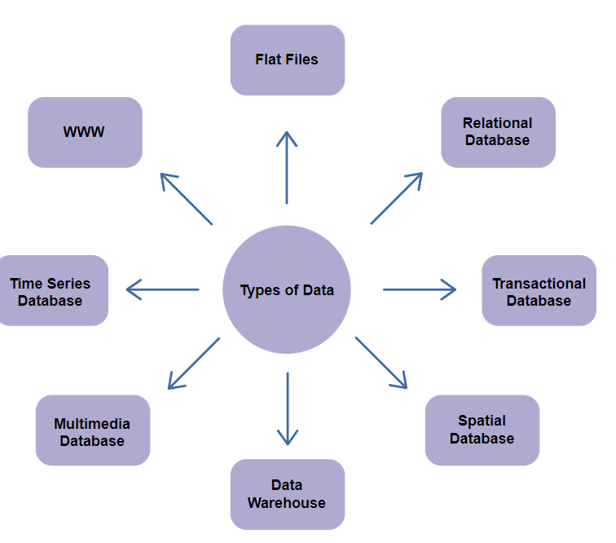
What Kinds of Data Can Be Mined?

Slide 29
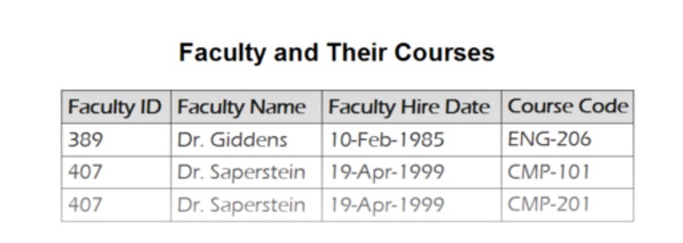
A flat file is a text or binary data file with a structure that data mining algorithms can easily extract. The data stored in the flat file has no relationship or path to each other. Flat files represent data dictionaries such as CSV files

Slide 30
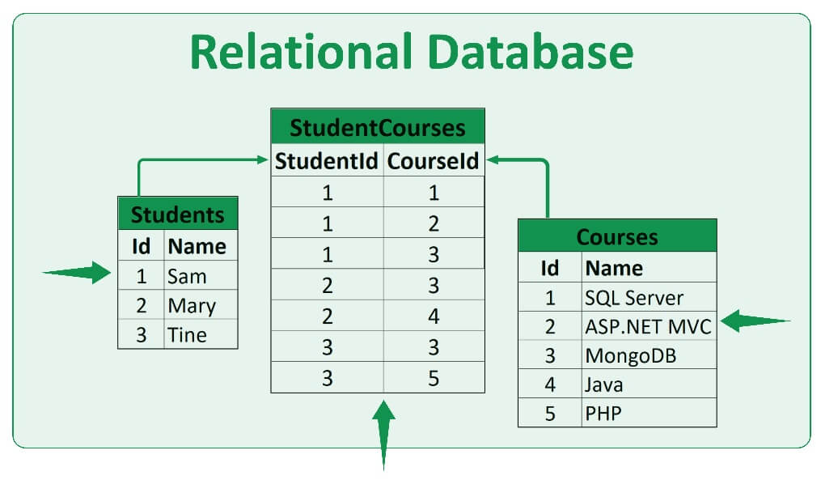
A relational database is a data collection organized into tables with rows and columns. It is mostly used in applications like Microsoft SQL Server, and Oracle Database.

Slide 31
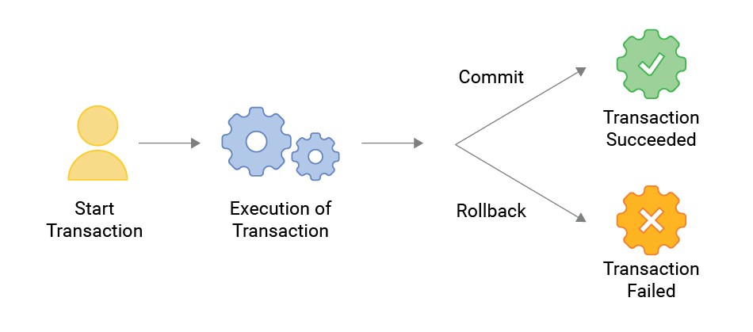
A transaction database is a data collection organized by timestamps, dates, and transactions. This database can roll back operations when a transaction is incomplete or committed. One application for this is banks, distributed systems, object databases, etc.
Transactions can be stored in a table, with one record per transaction.

Slide 32
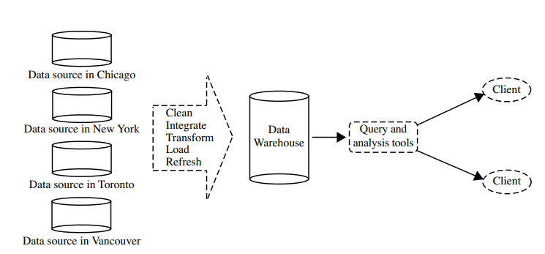
A data warehouse is a cluster of data that is integrated from multiple sources that have been queried and determined. It is widely used in everyday business decision-making.

Slide 33
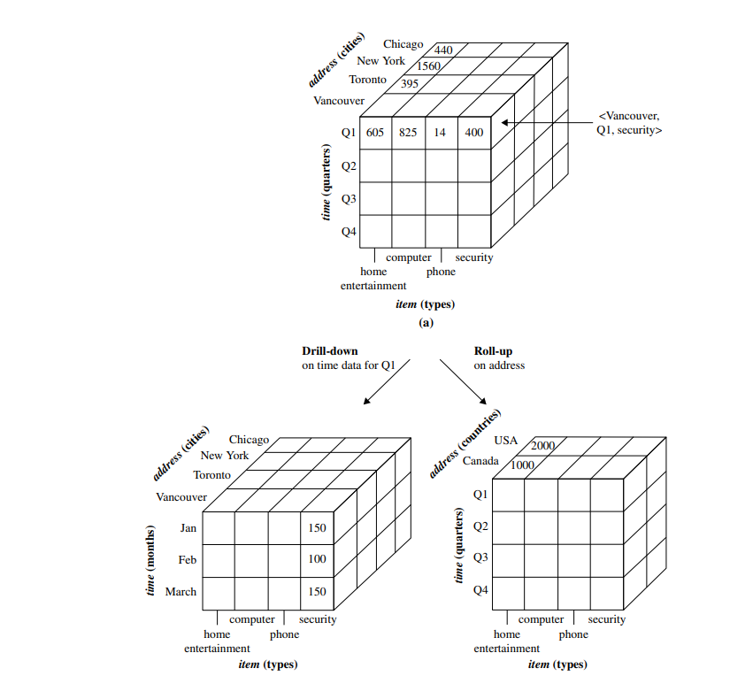
A data warehouse is usually modeled by a multidimensional data structure, called a data cube

Slide 34
Other Kinds of Data
World Wide Web - collection of documents and resources such as audio, video, and text.
Time-related or Sequence data - historical records, stock exchange data, and time-series and biological sequence data.
Data Streams -video surveillance and sensor data, which are continuously transmitted.
Spatial data –maps.
Engineering design data-the design of buildings, system components, or integrated circuits.
Hypertext and Multimedia data including text, image, video, and audio data,
Graph and networked data - social and information networks

Slide 35
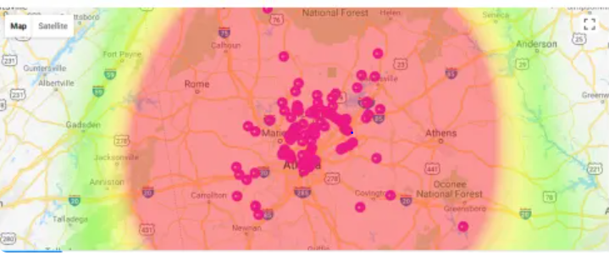
What kind of Patterns can be Mined?
Different types of data can be mined in data mining. However, the data should have a pattern to get helpful information.

Slide 36
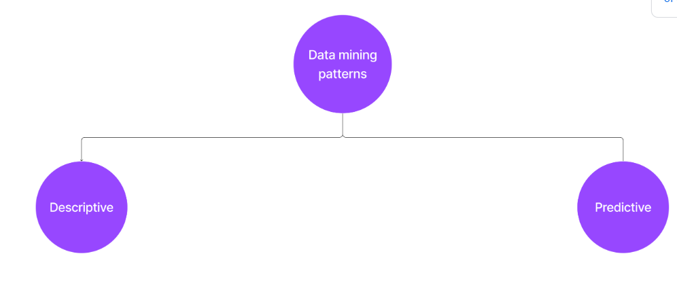
Based on the data functionalities, patterns can be further classified into two categories.

Slide 37
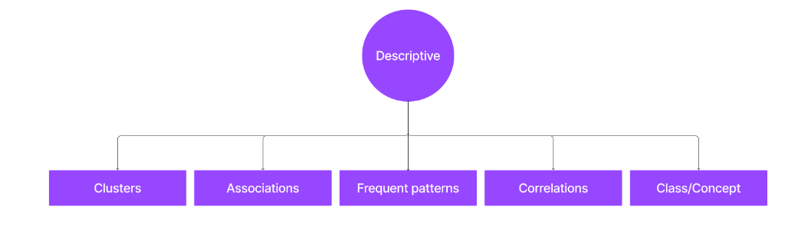
Descriptive patterns
It deals with the general characteristics and converts them into relevant and helpful information.
Descriptive patterns can be divided into the following patterns:

Slide 38
Class/concept description: Data entries are associated with labels or classes.
Classes of items for sale include computers and printers
Customer concept include big spender and budget spender which purchasing items.
The classes must be described in clear and concise terms which is known as ” class / concept description “.
Class / Concept can be classified as Data Characterization and Data Discrimination

Slide 39
Data Characterization – This is summarizing the data of target class based on features.
Produce a description of summarizing the characteristics of customer whole spend Rs 3000 in last 6 months.
The result could be a general profile of customers such as 40–50-year-old, employed, credit rating and other features.
Data Discrimination – This compares the target class with one or more comparative classes called the contrasting classes.
Compare features of software products whose sales up by 10 % in last year with software product whose sales went down by 30%.

Slide 40
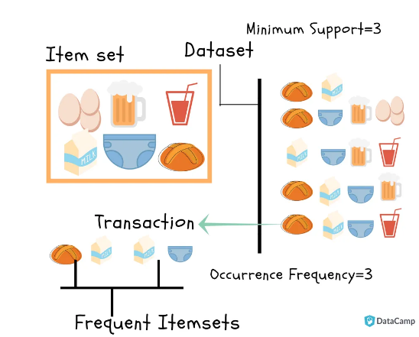
Mining Frequent Patterns, Associations, and Correlations
Frequent patterns: These are data points that occur more often in the dataset. There are many kinds of recurring patterns, such as frequent items, frequent subsequence, and frequent sub-structure.
Association Analysis
Association analysis identify relationship between items that are bought together during transactions.

Slide 41
Example: A store want to known which is purchased together. So they created rules such as buys(X, "computer") => buys(X, accessories") [support = 1%, confidence = 50%] where X is the customer, the confidence or certainty is 50% means if X buys computer, there is 50% chance that he will buy computer accessories. Support means of all transaction % is where computer and computer accessories bought together.
Correlations: This is performed to find the statistical correlations between two data points to find if they have positive, negative, or no effect.

Slide 42
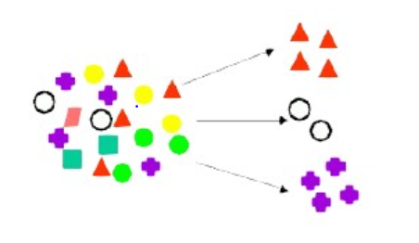
Clusters: This is the formation of a group of similar data points. Each point in the collection is somewhat similar but very different from other members of different groups.

Slide 43
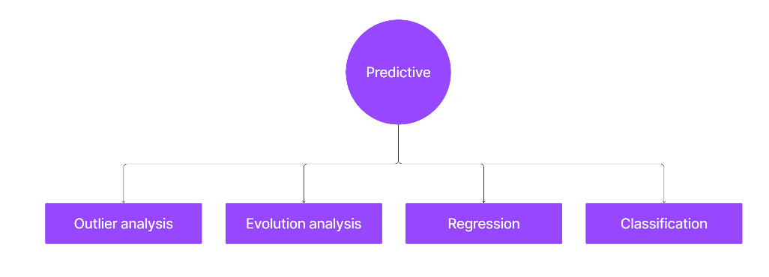
Predictive patterns
It predicts future values by analyzing the data patterns and their outcomes based on the previous data. It also helps us find missing values in the data.
Predictive patterns can be categorized into the following patterns.

Slide 44
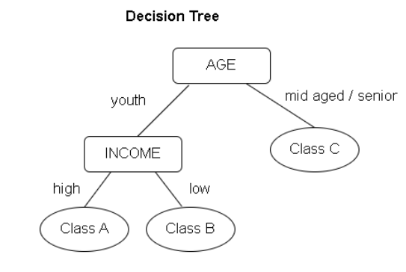
Classification: It helps predict the label of unknown data points with the help of known data points. For instance, if we have a dataset of X-rays of cancer patients, then the possible labels would be cancer patient and not cancer patient.

Slide 45
Regression: Unlike classification, regression is used to find the missing numeric values from the dataset. It is also used to predict future numeric values as well.
For example, we can find the behavior of the next year's sales based on the past twenty years' sales by finding the relation between the data.

Slide 46
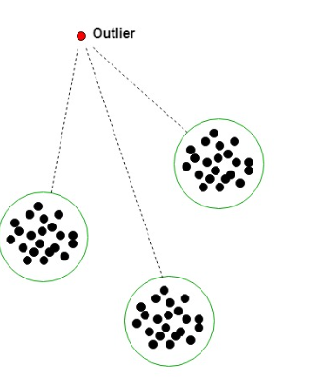
Outlier analysis: Not all data points in the dataset need to follow the same behavior. Data points that don't follow the usual behavior are called outliers. Analysis of these outliers is called outlier analysis. These outliers are not considered while working on the data.

Slide 47
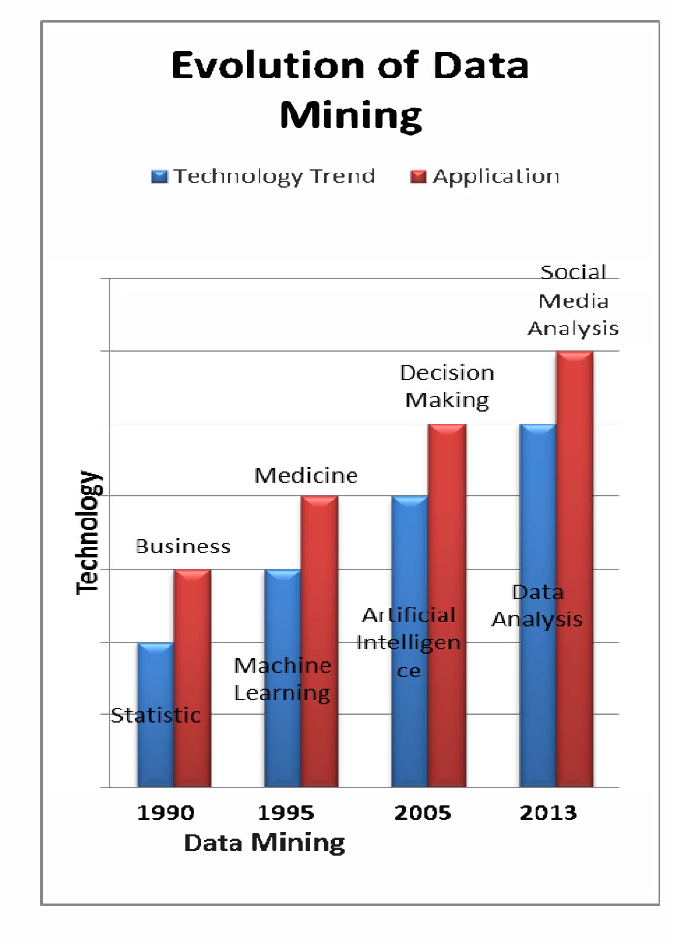
Evolution analysis: As the name suggests, those data points change their behavior and trends with time.

Slide 48
Measuring Data Similarity and Dissimilarity
Similarity
The similarity between two objects is a numerical measure of the degree to which the two objects are alike.
Similarities are higher for pairs of objects that are more alike.
Similarities are usually non-negative and are often between 0 (no similarity) and 1
(complete similarity).
Dissimilarity
The dissimilarity between two objects is a numerical measure of the degree to which
the two objects are different.
Dissimilarities are lower for more similar pairs of objects.
The term distance is used as a synonym for dissimilarity, although the distance is often used to refer to a special class of dissimilarities.
Dissimilarities sometimes fall in the interval [0,1], but it is also common for them to
range from 0 to ∞.
Proximity refers to a similarity or dissimilarity

Slide 49
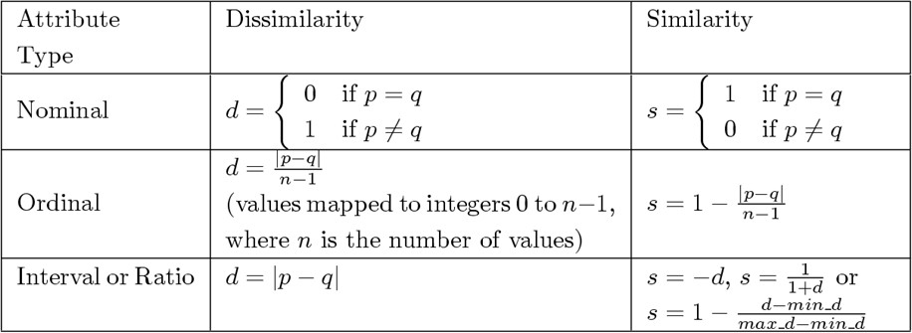
Similarity/Dissimilarity for Simple Attributes
The proximity of objects with a number of attributes is typically defined by
combining the proximities of individual attributes.
p and q are the attribute values for two data objects

Slide 50
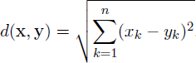
Dissimilarities between Data Objects
Distance on Numeric Data: Euclidean Distance
Assume that our data objects have n numeric attributes.
Euclidean Distance
where n is the number of attributes and x_{k} and x_{k} are k^{th} attributes of data objects x and y.
Normally attributes are numeric.
Standardization is necessary, if scales of attributes differ.

Slide 51
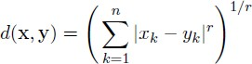
Distance on Numeric Data: Minkowski Distance
Minkowski Distance is a generalization of Euclidean Distance
where
r is a parameter,
n is the number of attributes and
x_{k} and y_{k} are k^{th} attributes of data objects x and x.
Note that Minkowski Distance is Euclidean Distance when r=2

Slide 52
Properties of Similarities
If s(x, y) is the similarity between points x and y, then the typical properties of
similarities are:
Positivity
s(x, y) = 1 only if x = y. (0 ≤ s(x,y) ≤ 1)
Symmetry
s(x, y) = s(y, x) for all x and y.

Slide 53
Proximity Measures for Binary Attributes
Let x and y be two data objects that consist of n binary attributes.
The comparison of two such objects, i.e., two binary vectors, leads to the following four frequencies:
f₀₀ = the number of attributes where x is 0 and y is 0 f₀₁ = the number of attributes where x is 0 and y is 1 f₁₀ = the number of attributes where x is 1 and y is 0 f₁₁ = the number of attributes where x is 1 and y is 1
Distance measure for symmetric binary variables:
𝐝 𝐱, 𝐲 =
^{𝐟}𝟎𝟏 ^{+ 𝐟}𝟏𝟎
^{𝐟}𝟎𝟎 ^{+ 𝐟}𝟎𝟏 ^{+ 𝐟}𝟏𝟎 ^{+ 𝐟}𝟏𝟏
Distance measure for asymmetric binary variables:
𝐝 𝐱, 𝐲 =
^{𝐟}𝟎𝟏 ^{+ 𝐟}𝟏𝟎
^{𝐟}𝟎𝟏 ^{+ 𝐟}𝟏𝟎 ^{+ 𝐟}𝟏𝟏

Slide 54
Similarity Between Binary Vectors:
Simple Matching and Jaccard Coefficients
Similarity measures between objects that contain only binary attributes are called
similarity coefficients, and typically have values between 0 and 1.
Simple Matching Coefficient (SMC) counts both presences and absences equally and it is normally used for symmetric binary attributes.
𝐧𝐮𝐦𝐛𝐞𝐫 𝐨𝐟 𝐦𝐚𝐭𝐜𝐡𝐢𝐧𝐠 𝐚𝐭𝐭𝐫𝐢𝐛𝐮𝐭𝐞𝐬
𝐒𝐌𝐂 = =
^{𝐟}𝟏𝟏 ^{+ 𝐟}𝟎𝟎
𝐧𝐮𝐦𝐛𝐞𝐫 𝐨𝐟 𝐚𝐭𝐭𝐫𝐢𝐛𝐮𝐭𝐞𝐬
^{𝐟}𝟎𝟎 ^{+ 𝐟}𝟎𝟏 ^{+ 𝐟}𝟏𝟎 ^{+ 𝐟}𝟏𝟏
Jaccard Coefficient (J) counts only presences and it is frequently for asymmetric binary attributes.
𝐧𝐮𝐦𝐛𝐞𝐫 𝐨𝐟 𝟏𝟏 𝐦𝐚𝐭𝐜𝐡𝐞𝐬
𝐉 = =
^{𝐟}𝟏𝟏
𝐧𝐮𝐦𝐛𝐞𝐫 𝐨𝐟 𝐧𝐨𝐭 − 𝐛𝐨𝐭𝐡 − 𝐳𝐞𝐫𝐨 𝐚𝐭𝐭𝐫𝐢𝐛𝐮𝐭𝐞𝐬
^{𝐟}𝟎𝟏 ^{+ 𝐟}𝟏𝟎 ^{+ 𝐟}𝟏𝟏

Slide 55
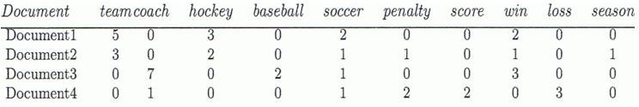
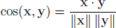
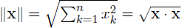
Cosine Similarity
A document can be represented by thousands of attributes, each recording the
frequency of a particular word or phrase in the document.
A similarity measure for documents needs to ignores 0–0 matches like the Jaccard measure, but also must be able to handle non-binary vectors.
Cosine similarity is one of the most common measure of document similarity.
where x and y are two document vectors
and ||x|| is the length of
where • indicates vector dot product vector x.

Slide 56
Cosine Similarity : Example
x = (3, 2, 0, 5, 0, 0, 0, 2, 0, 0)
y = (1, 0, 0, 0, 0, 0, 0, 1, 0, 2)
cos(x,y) = (x.y) / (||x|| ||y||) = 5 / (6.48*2.24) = 0.34

Slide 57
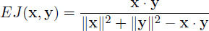
Extended Jaccard Coefficient
Extended Jaccard Coefficient can be used for document data and that reduces to the
Jaccard coefficient in the case of binary attributes.
Extended Jaccard Coefficient is also known as Tanimoto coefficient.

Slide 58
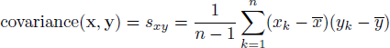
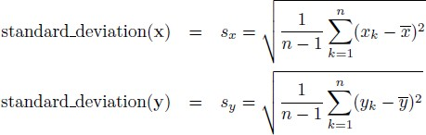
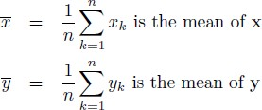
Correlation
Correlation measures the linear relationship between objects
Pearson's correlation coefficient between two data objects, x and y:
where

Slide 59
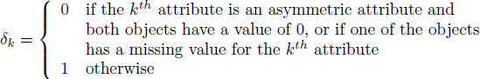
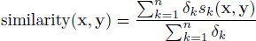
General Approach for Combining Similarities
Sometimes attributes are of many different types, but an overall similarity is needed.
The following algorithm is effective for computing an overall similarity between two heterogeneous objects, x and y, with different types of attributes.
1: For the k^{th} attribute, compute a similarity, s_{k}(x,y), in the range [0,1]. 2: Define an indicator variable, δ_{k}, for the k^{th} attribute as follows:
3: Compute the overall similarity between the two objects using the following formula:

Slide 60
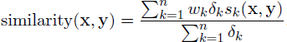
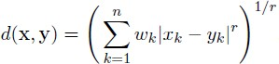
Using Weights to Combine Similarities
We may not want to treat all attributes the same.
Use weights w_{k} which are between 0 and 1 and they sum to 1.
Modified Minkowski distance

Slide 61
Selecting the Right Proximity Measure
For many types of dense, continuous data, metric distance measures such as Euclidean distance are often used.
The cosine, Jaccard, and extended Jaccard measures are appropriate for sparse, asymmetric data, most objects have only a few of the characteristics described by the attributes and thus, are highly similar in terms of the characteristics they do not have.
In some cases, transformation or normalization of the data is important for obtaining a proper similarity measure since such transformations are not always present in proximity measures.
The proper choice of a proximity measure can be a time-consuming task that requires careful consideration of both domain knowledge and the purpose for which the measure is being used.
A number of different similarity measures may need to be evaluated to see which ones produce results that make the most sense.

Slide 62
Basic Statistical Descriptions of Data
Basic statistical descriptions can be used to identify properties of the data and highlight which data values should be treated as noise or outliers.
For data preprocessing tasks, we want to learn about data characteristics regarding both central tendency and dispersion of the data.
Measures of central tendency include mean, median, mode, and midrange.
Measures of data dispersion include quartiles, interquartile range (IQR), and variance.
These descriptive statistics are of great help in understanding the distribution of the data.

Slide 63
Mean
The most common and most effective numerical measure of the “center” of a set of
data is the arithmetic mean.
1
n
n
x =
∑ i
Arithmetic Mean:
x
i=1
Sometimes, each value x_{i} in a set may be associated with a weight w_{i}.
– The weights reflect the significance and importance attached to their respective values.
n
∑ ^{w}i ^{x}i
Weighted Arithmetic Mean:
_{x =} i=1
n
∑ ^{w}i
i=1

Slide 64
Median
Another measure of the center of data is the median.
Suppose that a given data set of N distinct values is sorted in numerical order.
If N is odd, the median is the middle value of the ordered set;
If N is even, the median is the average of the middle two values.
In probability and statistics, the median generally applies to numeric data; however, we may extend the concept to ordinal data.
Suppose that a given data set of N values for an attribute X is sorted in increasing order.
If N is odd, then the median is the middle value of the ordered set.
If N is even, then the median may not be not unique.
In this case, the median is the two middlemost values and any value in between.

Slide 65
Mode
Another measure of central tendency is the mode.
The mode for a set of data is the value that occurs most frequently in the set.
It is possible for the greatest frequency to correspond to several different values, which results in more than one mode.
Data sets with one, two, or three modes: called unimodal, bimodal, and trimodal.
At the other extreme, if each data value occurs only once, then there is no mode.
Central Tendency Measures for Numerical Attributes: Mean, Median, Mode
Central Tendency Measures for Categorical Attributes: Mode
Central Tendency Measures for Nominal Attributes: Mode
Central Tendency Measures for Ordinal Attributes: Mode, Median

Slide 66
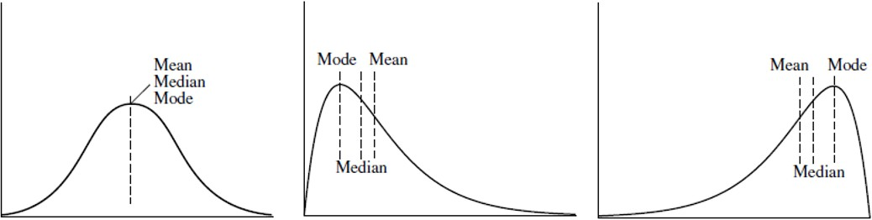
Measuring Central Tendency -
Mean, Median, Mode
Median, mean and mode of symmetric, positively and negatively skewed data
symmetric data
positively skewed data
negatively skewed data

Slide 67
Example
What are central tendency measures (mean, median, mode)for the following attributes? attr1 = {2,4,4,6,8,24}
mean = (2+4+4+6+8+24)/6 = 8
median = (4+6)/2 = 5
mode = 4
attr2 = {xs,s,s,s,m,m,l}
average of all values
avg. of two middle values
most frequent item
mean is meaningless for categorical attributes.
median = s mode = s
middle value
most frequent item

Slide 68
Measuring Dispersion of Data
The degree to which numerical data tend to spread is called the dispersion, or
variance of the data.
The most common measures of data dispersion:
Range: Difference between the largest and smallest values.
Interquartile Range (IQR): range of middle 50%
– quartiles: Q1 (25th percentile), Q3 (75th percentile)
IQR=Q3-Q1
– five number summary: Minimum, Q1, Median, Q3, Maximum
Variance and Standard Deviation:
– variance of N observations:
𝑛
(sample: s, population: σ)
𝑛
where μ is the mean value of the observations
1
1
2
2
𝜎 = ෍(𝑥 − 𝜇)
𝑠² =
෍(𝑥 − 𝜇)²
𝑛
𝑖
𝑛 − 1
𝑖
1 1
– standard deviation σ (s) is the square root of variance σ² ( s²)

Slide 69
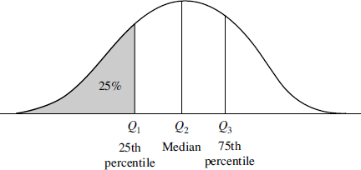
Quartiles
Suppose that set of observations for numeric attribute X is sorted in increasing order.
Quantiles are points taken at regular intervals of a data distribution, dividing it into essentially equal size consecutive sets.
The k^{th} q-quantile for a given data distribution is the value x such that at most k/q of the data values are less than x and at most (q-k)/q of the data values are more than x, where k is an integer such that 0<k<q. There are q-1 q-quantiles.
The 100-quantiles are more commonly referred to as percentiles; they divide the data distribution into 100 equal-sized consecutive sets.
Quartiles: The 4-quantiles are the three data points that split the data distribution into
four equal parts; each part represents one-fourth of the data distribution.

Slide 70
Outliers
Outliers can be identified by the help of interquartile range or standard deviation
measures.
Suspected outliers are values falling at least 1.5xIQR above the third quartile or below the first quartile.
Suspected outliers are values that fall outside of the range of μ–Nσ and μ+Nσ where μ is mean and σ is standard deviation.

Slide 71
Graphic Displays of Basic Statistical Descriptions
Boxplot: graphic display of five-number summary
Bar Chart: compare data across different categories.
Histogram: x-axis are values, y-axis represent frequencies
Quantile plot: each value x_{i} is paired with f_{i} indicating that approximately 100 f_{i} % of data are  x_{i}
Scatter plot: each pair of values is a pair of coordinates and plotted as points in the plane.

Slide 72
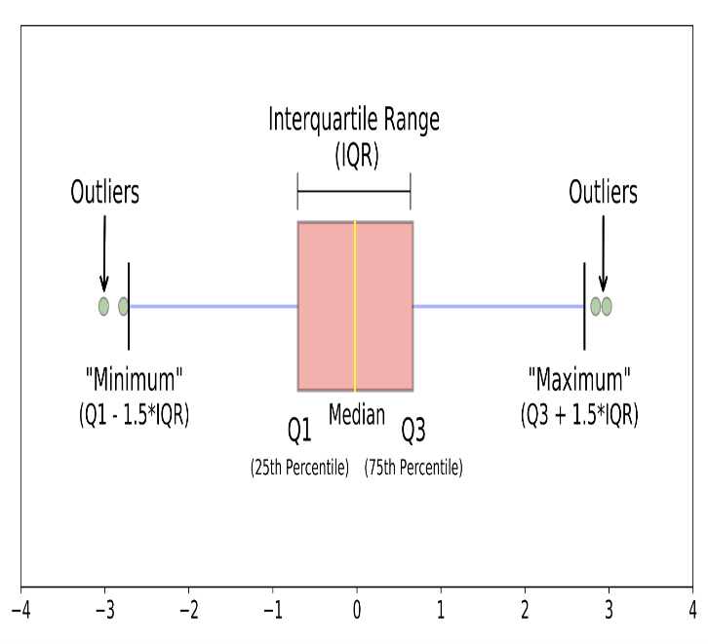
Boxplot
Median. The middle value of a dataset where 50% of the data is less than the median and 50% of the data is higher than the median.
The upper quartile. The 75th percentile of a dataset where 75% of the data is less than the upper quartile, and 25% of the data is higher than the upper quartile.
The lower quartile. The 25th percentile of a dataset where 25% of the data is less than the lower quartile and 75% is higher than the lower quartile.
The interquartile range. The upper quartile minus the lower quartile
The upper adjacent value. Generally, the “maximum.” It represents the upper quartile plus 1.5 times the interquartile range.
The lower adjacent value. Generally, the “minimum." It represents the lower quartile minus 1.5 times the interquartile range.
Outliers. Any values above the “maximum” or below the “minimum.

Slide 73
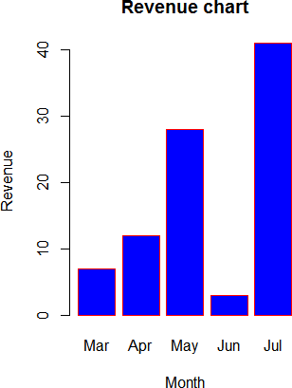
Bar Chart
A bar chart represents data in rectangular bars with length of the bar proportional to the value of the variable.

Slide 74
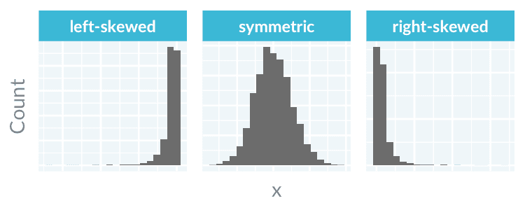
Histogram
To build a histogram, the numerical data is first divided into several ranges or bins, and the frequency of occurrence of each range is counted. The horizontal axis shows the range, while the vertical axis represents the frequency or percentage of occurrences of a range.

Slide 75
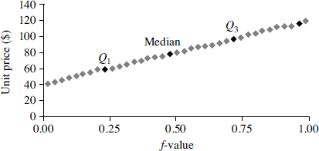
Quantile Plot
Displays all of the data (allowing the user to assess both the overall behavior and unusual occurrences)
Plots quantile information
– For a data x_{i} data sorted in increasing order, f_{i} indicates that approximately 100 f_{i}% of the data are below or equal to the value x_{i}

Slide 76
Scatter Plot
A scatter plot is one of the most effective graphical methods for determining if there appears to be a relationship, pattern, or trend between two numeric attributes.
–
Two attributes, X, and Y, are correlated if one attribute implies the other.
Correlations can be positive, negative, or null (uncorrelated).

Slide 77
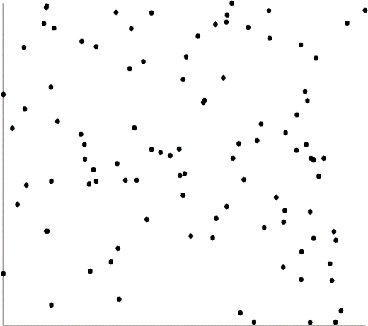
Scatter Plot:
Positively and Negatively Correlated Data
Negatively Correlated
Positively Correlated
Uncorrelated

Slide 78
Data Visualization Tools
Tableau
Infogram
Datawrapper
Plotly
Chartblocks

Slide 79

Data mining adopts techniques from many domains.

Slide 80
Statistics
Statistics studies the collection, analysis, interpretation or explanation, and presentation of data.
A statistical model is a set of mathematical functions that describe the behavior of the objects in a target class in terms of random variables and their associated probability distributions.
Statistics research develops tools for prediction and forecasting using data and statistical models.

Slide 81

Machine Learning
Supervised learning is basically a synonym for classification. The supervision in the learning comes from the labeled examples in the training data set.

Slide 82

Unsupervised learning is a type of machine learning where the algorithm learns from unlabeled data without any predefined outputs or target variables

Slide 83

Semi-supervised learning is a class of machine learning techniques that make use of both labeled and unlabeled examples when learning a model. In one approach, labeled examples are used to learn class models and unlabeled examples are used to refine the boundaries between classes.

Slide 84
Database Systems and Data Warehouses
Database systems high scalable in processing very large, relatively structured data sets. Many data mining tasks need to handle large data sets or even real-time, fast streaming data. Therefore, data mining can make good use of scalable database technologies to achieve high efficiency and scalability on large data sets.
A data warehouse integrates data originating from multiple sources and various timeframes. It consolidates data in multidimensional space to form partially materialized data cubes.

Slide 85
Information retrieval (IR) is the science of searching for documents or information in documents. Documents can be text or multimedia and may reside on the Web. Information retrieval assumes that
the data under search are unstructured; and
(2) the queries are formed mainly by keywords

Slide 86

Which Kinds of Applications Are Targeted?

Slide 87

Data Mining Issues

